Slide 1
Introduction to Dynamic Routing Protocol

Slide 2
Objectives
Describe the role of dynamic routing protocols and place these protocols in the context of modern network design.
Identify several ways to classify routing protocols.
Describe how metrics are used by routing protocols and identify the metric types used by dynamic routing protocols.
Determine the administrative distance of a route and describe its importance in the routing process.
Identify the different elements of the routing table.

Slide 3
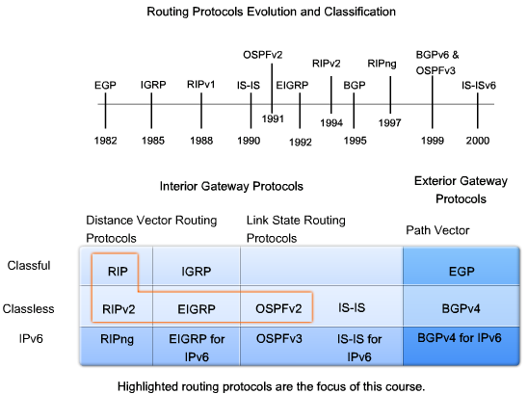
Dynamic Routing Protocols

Slide 4
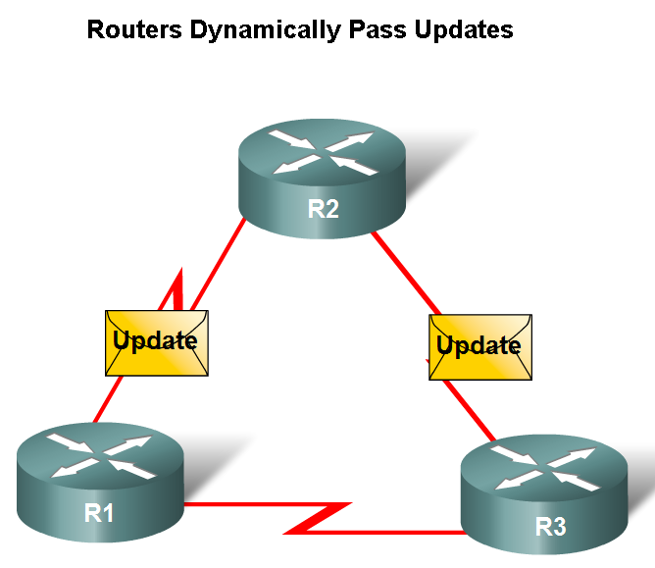
Dynamic Routing Protocols
Function(s) of Dynamic Routing Protocols:
  -Dynamically share information between routers.
  -Automatically update routing table when topology changes.
  -Determine best path to a destination.

Slide 5
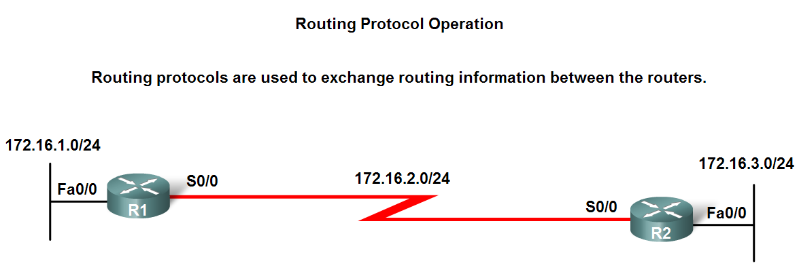
Dynamic Routing Protocols
The purpose of a dynamic routing protocol is to:
  -Discover remote networks
  -Maintaining up-to-date routing information
  -Choosing the best path to destination networks
  -Ability to find a new best path if the current path is no longer available

Slide 6
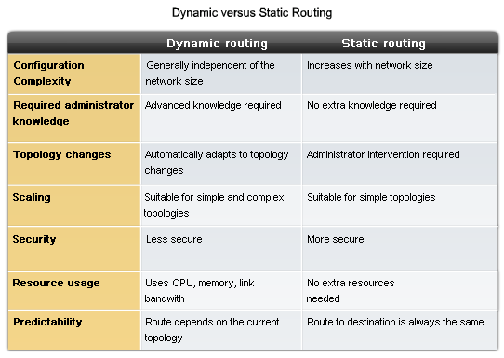
Dynamic Routing Protocols

Slide 7
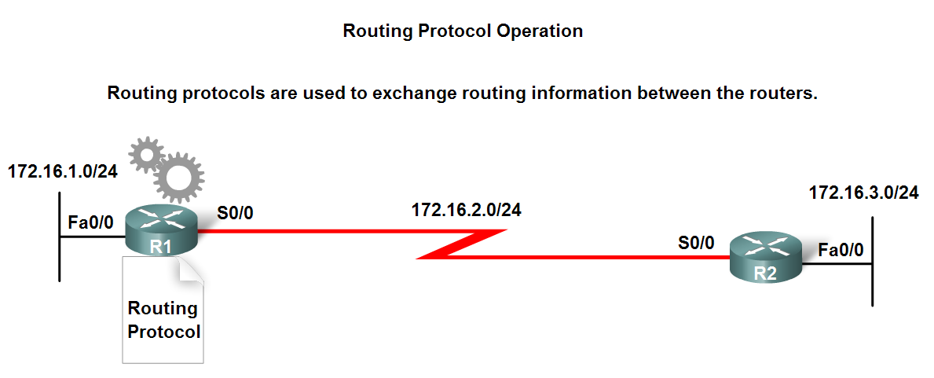
Dynamic Routing Protocols
Components of a routing protocol
  Algorithm
    In the case of a routing protocol algorithms are used for facilitating routing information and best path determination
  Routing protocol messages
    These are messages for discovering neighbors and exchange of routing information

Slide 8
Dynamic Routing Protocols
Advantages of static routing
  -It can backup multiple interfaces/networks on a router
  -Easy to configure
  -No extra resources are needed
  -More secure
Disadvantages of static routing
  -Network changes require manual reconfiguration
  -Does not scale well in large topologies

Slide 9
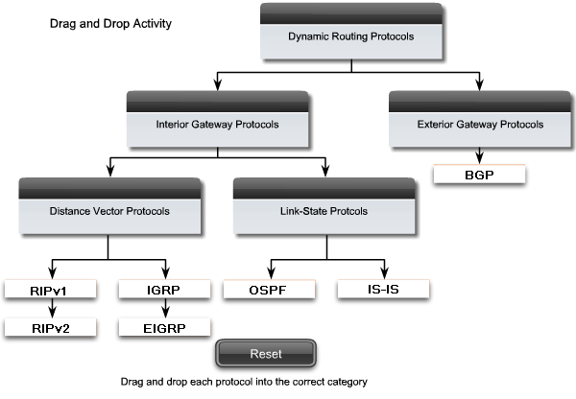
Classifying Routing Protocols
Dynamic routing protocols are grouped according to characteristics. Examples include:
Autonomous System is a group of routers under the control of a single authority.

Slide 10
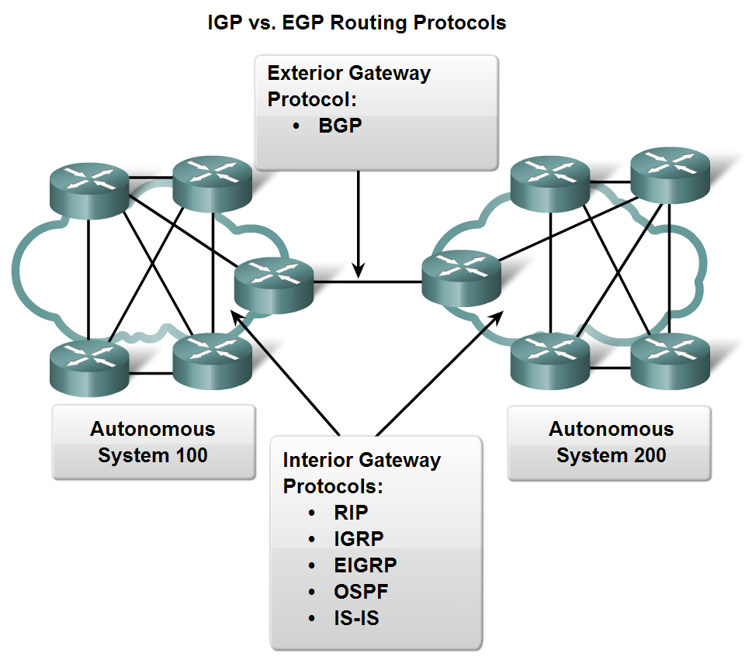
Classifying Routing Protocols
Types of routing protocols:
  -Interior Gateway Protocols (IGP)
  -Exterior Gateway Protocols (EGP)

Slide 11
Classifying Routing Protocols
Interior Gateway Routing Protocols (IGP)
  -Used for routing inside an autonomous system & used to route within the individual networks themselves.
  -Examples: RIP, EIGRP, OSPF
Exterior Routing Protocols (EGP)
  -Used for routing between autonomous systems
  -Example: BGPv4

Slide 12
Classifying Routing Protocols
IGP: Comparison of Distance Vector & Link State Routing Protocols
  Distance vector
  routes are advertised as vectors of distance & direction.
  incomplete view of network topology.
  Generally, periodic updates.
  Link state
  complete view of network topology is created.
  updates are not periodic.

Slide 13
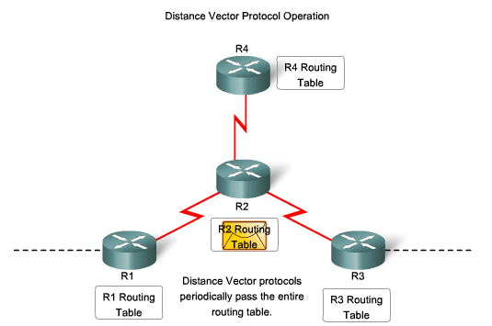
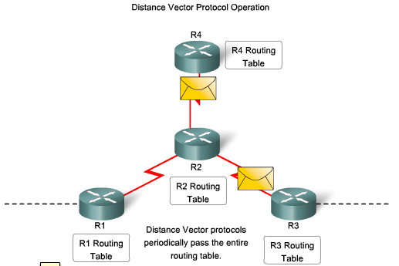
Classifying Routing Protocols

Slide 14
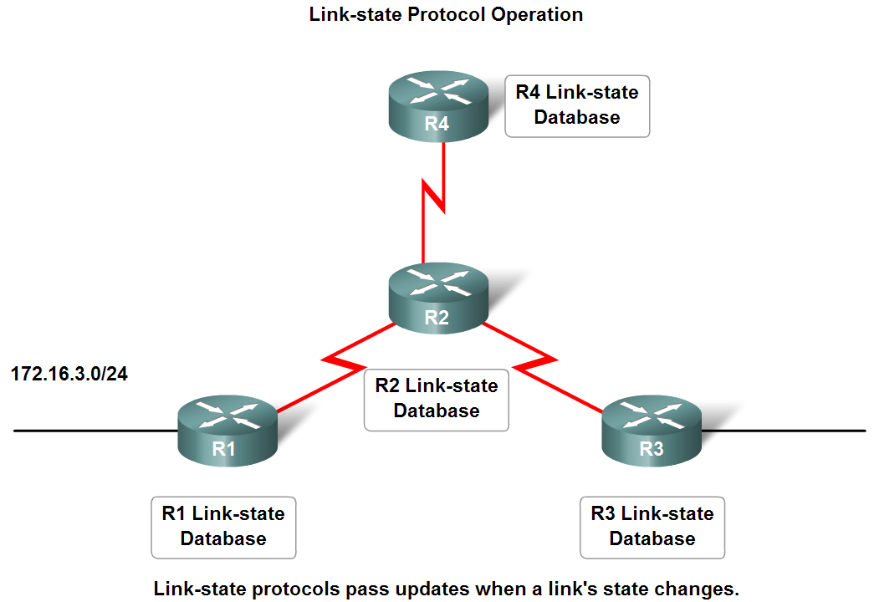
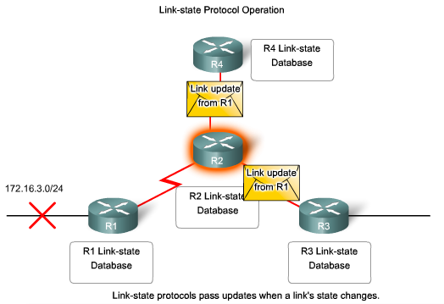
Classifying Routing Protocols

Slide 15
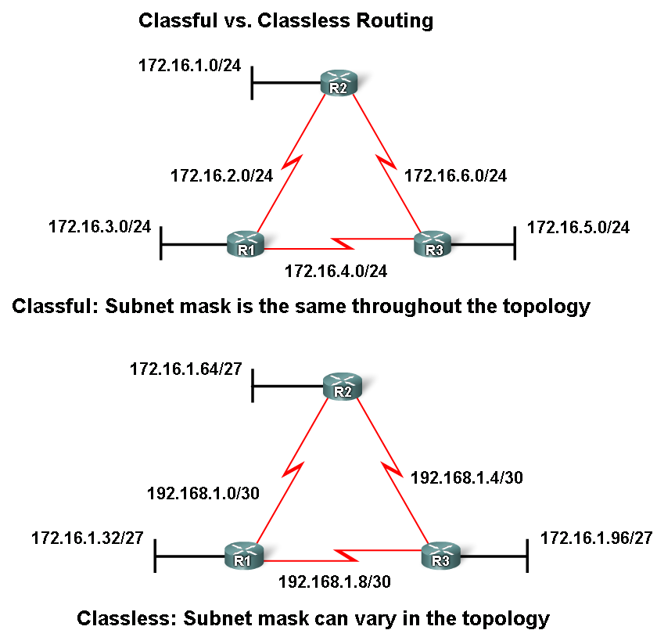
Classifying Routing Protocols
Classful routing protocols
  Do NOT send subnet mask in routing updates
Classless routing protocols
  send subnet mask in
  routing updates.

Slide 16
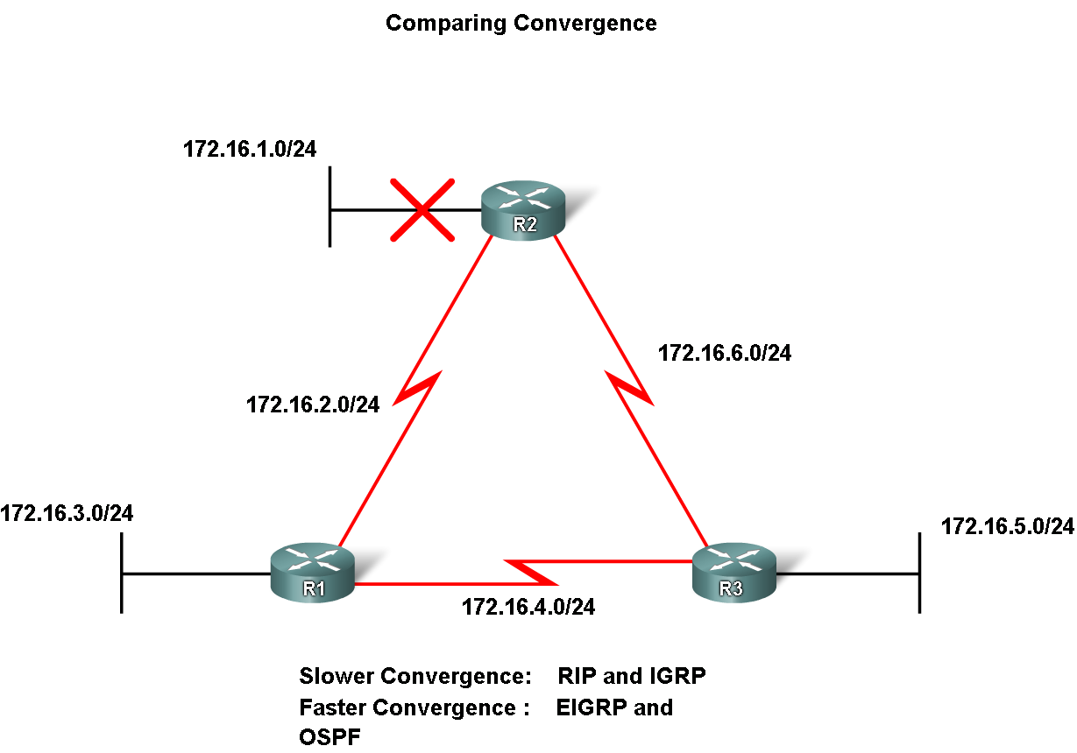
Classifying Routing Protocols
Convergence is defined as when all routers’ routing tables are at a state of consistency

Slide 17
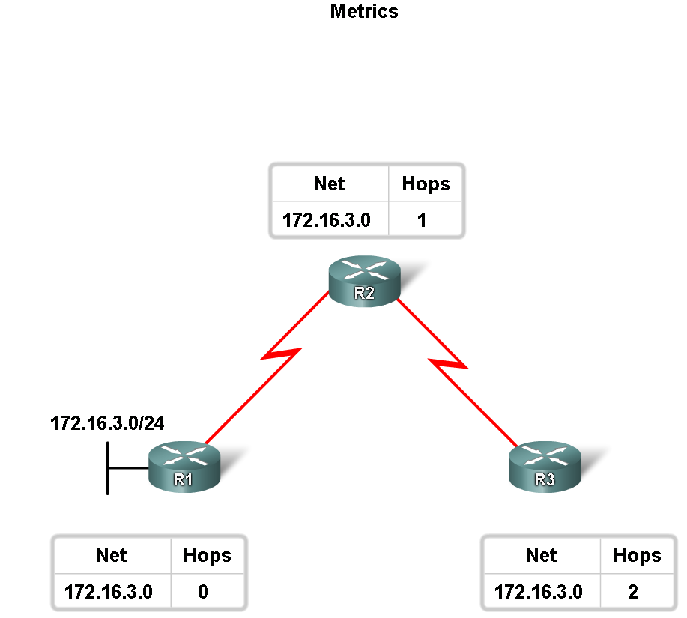
Routing Protocols Metrics
Metric
  A value used by a routing protocol to determine which routes are better than others.

Slide 18
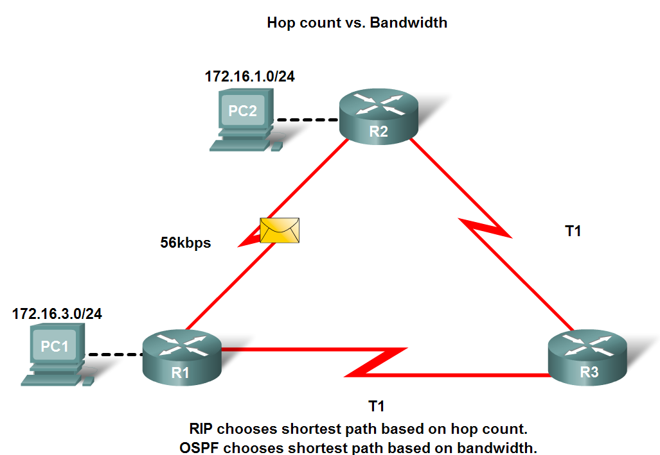
Routing Protocols Metrics
Metrics used in IP routing protocols
  -Bandwidth
  -Cost
  -Delay
  -Hop count
  -Load
  -Reliability

Slide 19

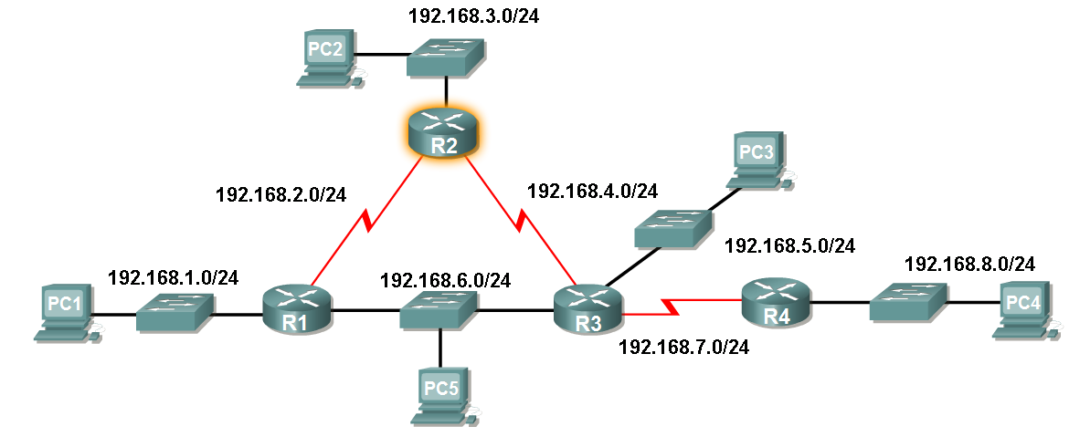
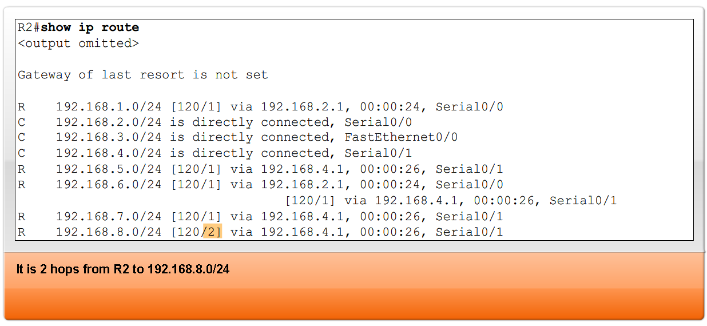
Routing Protocols Metrics
The Metric Field in the Routing Table
Metric used for each routing protocol
  -RIP - hop count
  -IGRP & EIGRP - Bandwidth (used by default), Delay (used by default), Load, Reliability,MTU
  -IS-IS & OSPF – Cost ( Bandwidth (Cisco’s implementation))

Slide 20
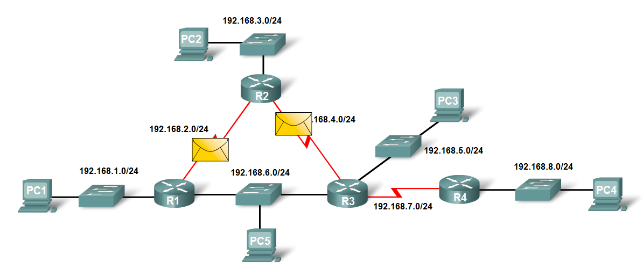
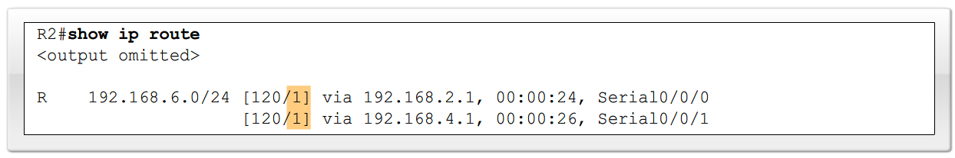
Routing Protocols Metrics
Load balancing
  This is the ability of a router to distribute packets among multiple same cost paths

Slide 21
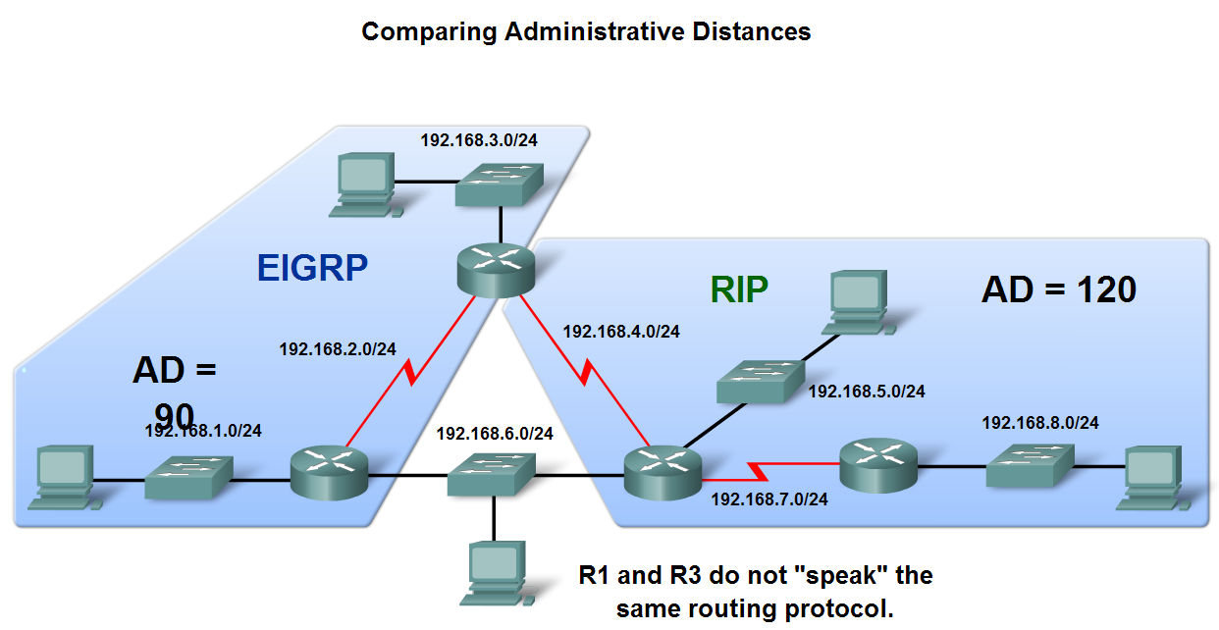
Administrative Distance of a Route
Purpose of a metric
  It’s a calculated value used to determine the best path to a destination
Purpose of Administrative Distance
  It’s a numeric value that specifies the preference of a particular route

Slide 22
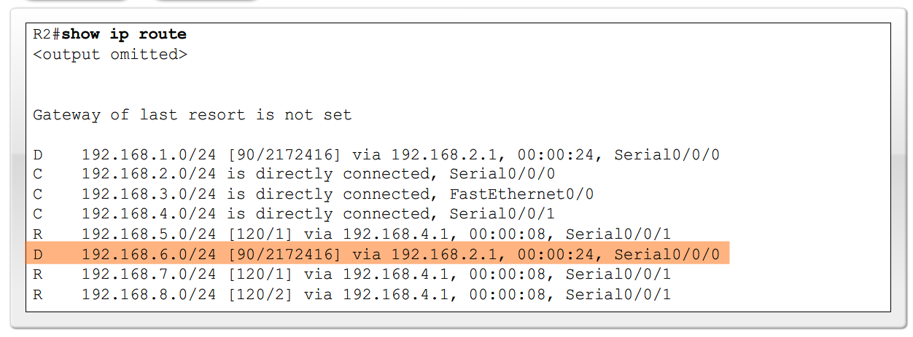
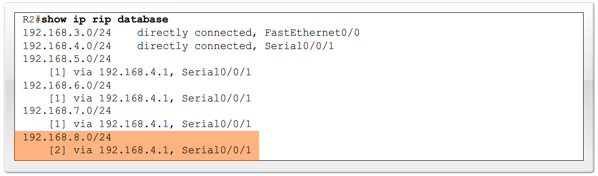
Administrative Distance of a Route
Identifying the Administrative Distance (AD) in a routing table
  It is the first number in the brackets in the routing table

Slide 23
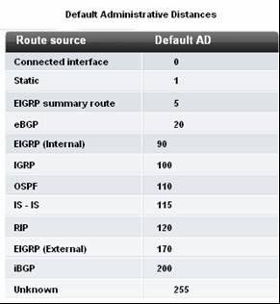
Administrative Distance of a Route
Dynamic Routing Protocols

Slide 24
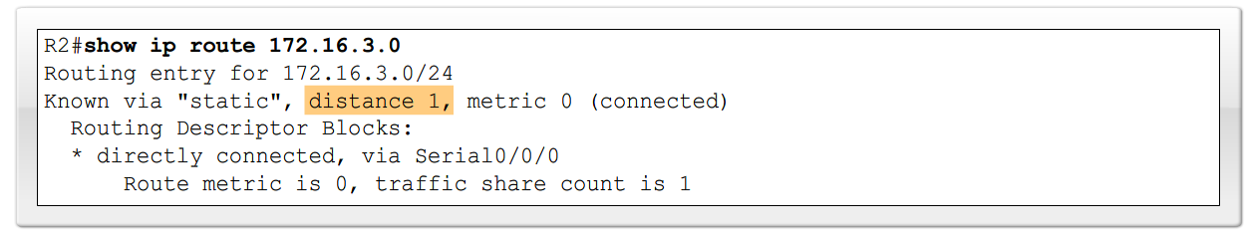
Administrative Distance of a Route
Directly connected routes
  Have a default AD of 0
Static Routes
  Administrative distance of a static route has a default value of 1

Slide 25
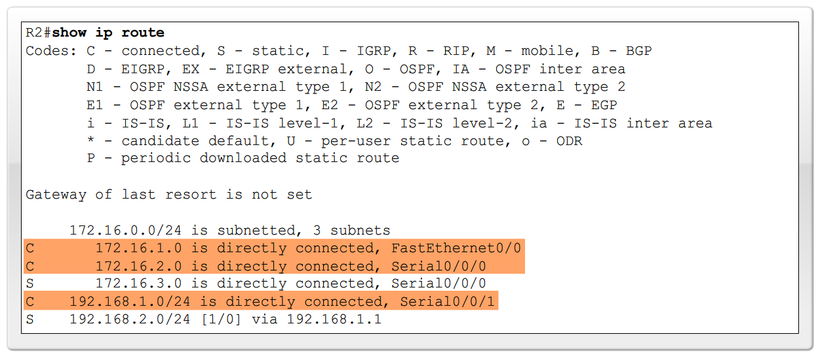
Administrative Distance of a Route
Directly connected routes
  -Immediately appear in the routing table as soon as the interface is configured

